Slide 1
Computer Principles for Programmers
Software Development:
Platforms, SDLC, Environments, Version Control
Notes:
Overview of OS and software development

Slide 2
Agenda
Lecture
Operating System Concepts
Hardware vs Software vs Firmware
Software Development
The Stack
SDLC
Environments
Version Control
APIs – Application Program Interface

Slide 3
Quiz

Slide 4
News of the Week

Slide 5
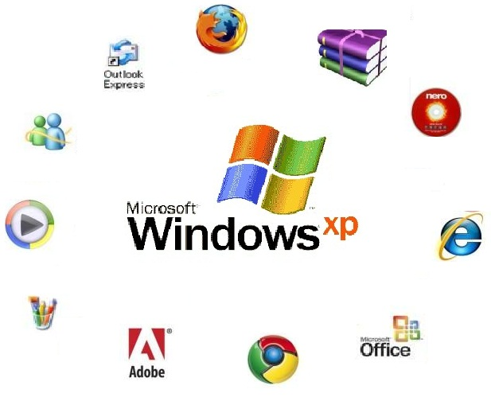
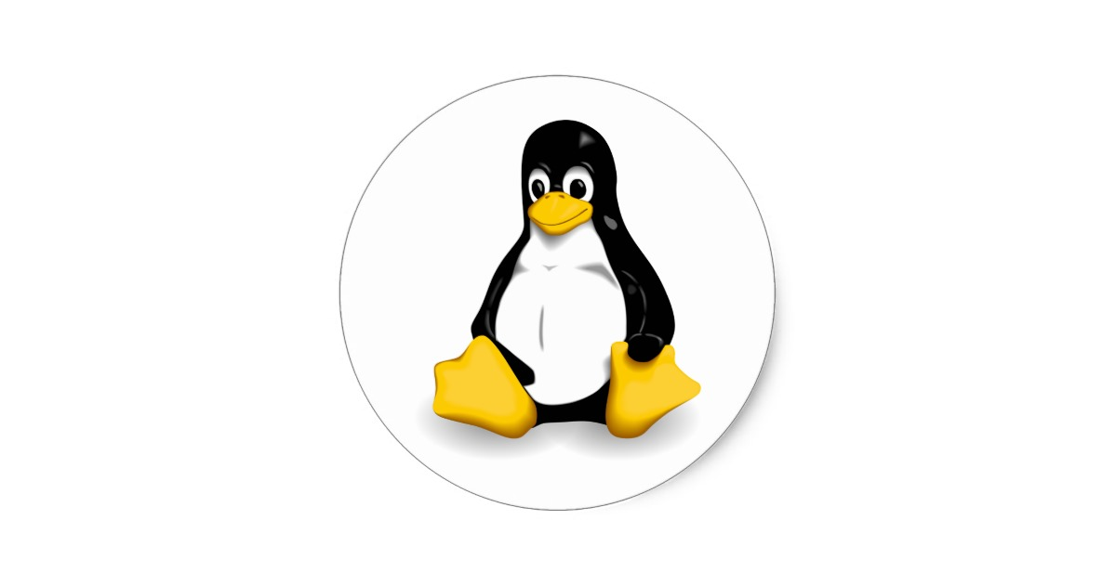
Systems
Operating System (OS) manages hardware & software resources, provides common services for Application Software.
Application Software
A program (or “app”) designed to perform a group of coordinated user functions, tasks, or activities in order to solve a problem.
Platform: hardware + OS
Software Dev: the stack
TUX penguin Torvald's UniX runs on the most hardware
Notes:
Server and small systems market share:
OS - A low level program that allows end user devices like keyboards, mice, and screens to communicate with computer hardware and controls the execution of application programs.
TUX is the Linux mascot. “(T)orvalds (U)ni(X)”.
https://en.wikipedia.org/wiki/Usage_share_of_operating_systems#Desktop_and_laptop_computers
Application Software, including Web Apps, is the primary focus of the School of ICT’s software development programs.
https://www.techopedia.com/definition/3411/platform
Platform is a combination of hardware + OS. E.g. “Wintel” which is Windows running on Intel CPU/hardware. macOS used to run on PowerPC architecture, now runs on Intel x86-64. Linux runs on almost anything. IBM has z (mainframe), Power servers running IBM i, AIX, Linux. https://www.youtube.com/watch?v=I0bBXPP5iWI
https://www.forbes.com/sites/patrickmoorhead/2018/03/19/headed-into-its-fifth-year-openpower-has-momentum-into-the-power9-generation/#65b93ef578a8
https://www.fool.com/investing/2018/03/22/googles-data-centers-now-have-ibm-inside.aspx
What are other platforms? iOS + Android tablets & smartphones (increasing shipments), Desktop + laptop PCs (declining shipments); in 2011 sales of mobile devices exceeded PCs. The big three personal computing platforms are Apple mac & iOS, Android, and Windows. Apple has 13.7% of smartphone market share in 2017Q1 but all of the profits. Android platforms have the rest of market share but little of the profit. Blackberry in-service devices are fading fast and their market share was zero in 2016Q4. The iOS App Store earned 75 percent more revenue than the Google Play Store in 2015 despite Apple's much smaller number of devices in service. Apple iOS users spend more than four dollars for every Android dollar on all purchases made through mobile devices.
The server market platforms: The most common operating system for mainframes is IBM's z/OS. In The midrange market is IBM Power Systems running AIX (UNIX) and IBM i/OS. The small server market includes Windows server and Linux servers.
Software Development "stacks" include LAMP (see later slide), Microsoft .NET deployed on Azure cloud, Visual Studio supports various stacks for mobile, web, and other development including the WIMP stack: Windows, Internet Information Services, MySQL , PHP, Python

Slide 6
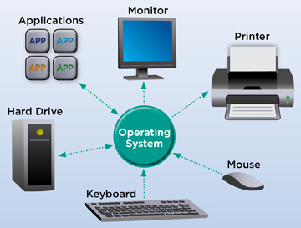
Operating System software that supports a computer's basic functions: schedule tasks, execute applications, control peripherals.
Applications
OS allocates memory & resources, security, APIs.
Operating System
Interrupts, Scheduling, I/O
User Interface
File systems
Networking
Hardware
CPU, RAM, peripheral devices.
Device drivers interact with OS
Notes:
https://en.wikipedia.org/wiki/Operating_system
Hypervisor can create virtual machines where multiple OSs share a portion of the same hardware. Large applications like database systems, web servers, ERP (Enterprise Resource Planning) run best on their own machine. The host OS is not struggling to balance competing resources as when all these complex systems are run within the same OS instance. It also makes vendor support for these large software packages easier (fewer run time variables) and harder for the vendor to blame a problem on another software package. Web servers talk to the DB servers through a virtual network linkage. There are numerous other reasons to run VMs such as running disparate OSs, experimentation, sandboxing experimental software, hosting an obsolete version of an OS to support an old but still useful application.
OS abstracts the Application software from the hardware. E.g. It presents a consistent view of a file system to application software even though files may reside on different media such as network mapped, HDD, SSD, and USB drives. Also SAN Storage Area Network, NAS Network Attached Storage.
PCs, tablets, smartphones are Single-user e.g. from DOS plus multi-tasking from server OS
Multi-user from IBM mainframes and Unix

Slide 7
OS provides Layered Architecture
End User
Programmer
Software Engineer
Hardware Engineer
Interface
Application Software
System Services
System Software
Hardware
Notes:
Users use Apps but they don’t change them. Programmers create Apps.
System Services are provided to Apps through APIs, Services are also high level Operating System functions that humans see and interact with such as the User Interface
System Services offered by operating systems:
User Interface to screen, keyboard, mouse, touchpads,
File system manipulation
Input / Output Operations between Apps and OS
Communications
Resource Allocation
Software Error Detection
Security controls
Software Engineers and computer scientists create system software. E.g. connecting APIs at the Services level with Hardware at the lowest level of the OS
Input / Output Operations between Services and Hardware levels
Security enforcement
Hardware Error Detection
Hardware (Electrical and Computer) Engineers design the hardware and low level system software that lets an operating system talk to the hardware. E.g. device drivers

Slide 8

Embedded Systems, Firmware and the Internet of Things
As of 2017, there are more IoT devices on the planet than people.
By 2018Q4, there will be more than twice as many.
In 2020, there will be GT three times as many… worth $7.1 trillion.
By Wilgengebroed on Flickr [CC BY 2.0 (http://creativecommons.org/licenses/by/2.0)], via Wikimedia Commons
Notes:
Embedded systems are small computers that have a microcontroller/microprocessor inside running a program from firmware.
AKA System on Chip (SoC) and MCU microcontroller unit with a processor, memory and programmable input/output peripherals. MCUs are designed for low-power embedded systems.
Over the forecast years of 2018-2026, the global IOT Microcontroller market is predicted to rise with 11.38% CAGR (Combined Annual Growth Rate). The IoT Microcontroller types include 8-BIT MCU, 16-BIT MCU, and 32-BIT MCU. It is the 32 bit version which will see the most growth.
Real Time – QNX is a real-time OS (Canadian invention now owned by Blackberry)
real-time computing (RTC), or reactive computing describes hardware and software systems subject to a "real-time constraint", for example from event to system response.^{[1]} Real-time programs must guarantee response within specified time constraints, often referred to as "deadlines".
e.g. automotive systems such as ABS Anti-lock Braking Systems and traction control
Examples: Digital alarm clocks, microwave ovens and other kitchen appliances, Christmas lights that blink in patterns, vehicles have many embedded systems: throttle control to go, automatic transmissions to continue going, traction control systems to go safely, ABS (Anti-skid Braking Systems) to stop in the minimum distance.
https://www.itworldcanada.com/article/breaking-news-microsoft-designs-secure-processor-for-iot/404123
Firmware is a combined OS and application running on small embedded systems. These systems have very limited storage. Your microwave oven might be capable of configuration as to whether it makes that annoying beep but it will not remember that you usually turn it on at 70% power for 4 minutes to heat up a can of soup.
Software is the most temporary and malleable. Firmware is semi-permanent software that’s tied more directly to the hardware and updated less often, and hardware is the physical components that are most permanent. IoT applications run on small devices where reduced processor use means less heat, where reduced memory footprint means smaller chips; all of which means reduced power consumption and better battery life. C language is particularly good at this.
Firmware plus networking is the basis of many IoT devices. https://en.wikipedia.org/wiki/Internet_of_things
Legal scholars suggest to look at "Things" as an "inextricable mixture of hardware, software, data and service".
The Internet of Things or IoT is the internetworking of physical devices, vehicles (also referred to as "connected devices" and "smart devices"), buildings, and other items—embedded with electronics, software, sensors, actuators, and network connectivity that enable these objects to collect and exchange data.
http://www.businessinsider.com/what-is-the-internet-of-things-definition-2016-8
The Internet of Things Needs a Code of Ethics
https://www.theatlantic.com/technology/archive/2017/05/internet-of-things-ethics/524802/
Social and Ethical Behavior in the Internet of Things (important article (referenced above) by Vint Cerf – a father of the internet – and Francine Berman, computer-science professor at Rensselaer Polytechnic Institute and a long-time expert on computer infrastructure. https://cacm.acm.org/magazines/2017/2/212443-social-and-ethical-behavior-in-the-internet-of-things/fulltext
Connectivity FYI: https://www.rs-online.com/designspark/eleven-internet-of-things-iot-protocols-you-need-to-know-about,
https://www.postscapes.com/internet-of-things-protocols/
http://datasmart.ash.harvard.edu/news/article/internet-of-things-in-focus-859
http://www.zdnet.com/article/your-forgotten-iot-gadgets-will-leave-a-disastrous-toxic-legacy/
http://www.zdnet.com/article/dell-outlines-iot-strategy-plans-to-spend-1-billion-on-r-d-over-three-years/
http://www.zdnet.com/article/iot-devices-will-outnumber-the-worlds-population-this-year-for-the-first-time/
Programming for embedded systems
https://barrgroup.com/embedded-systems/books/embedded-c-coding-standard
https://embeddedgurus.com/stack-overflow/2008/06/efficient-c-tips-1-choosing-the-correct-integer-size/

Slide 9
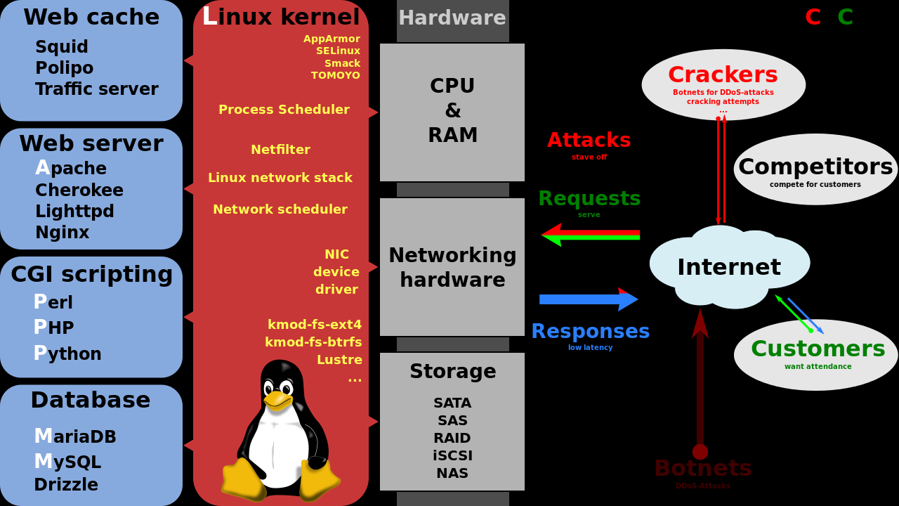
LAMP Stack: Linux, Apache, MySQL, PHP
By Shmuel Csaba Otto Traian, CC BY-SA 3.0, https://commons.wikimedia.org/w/index.php?curid=28224098
Notes:
Illustration By Shmuel Csaba Otto Traian, CC BY-SA 3.0, https://commons.wikimedia.org/w/index.php?curid=28224098
From https://en.wikipedia.org/wiki/LAMP_(software_bundle)
Traditional LAMP stack an open source web platform used to run dynamic web sites and servers. It includes Linux OS, Apache web server, MySQL database, and PHP/Python/Perl programming. Linux OS runs on a variety of hardware from small imbedded devices to PCs to IBM mainframes.
There are courses using aspects of this platform throughout the School of ICT.

Slide 10
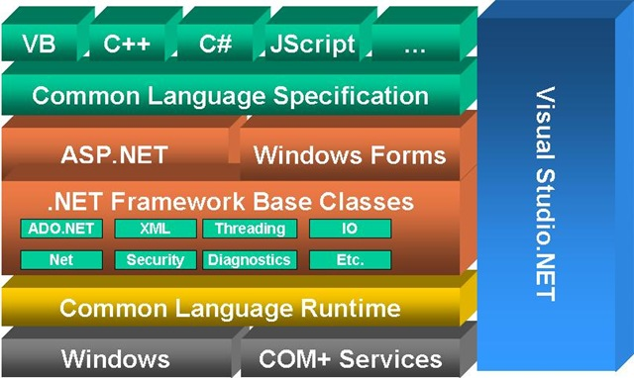
ASP.NET Development Stack
Virtual Machine
and macOS or Linux or iOS or Android
Notes:
The .NET platform can create local standalone applications deployed to a single PC (Windows Forms) although the browser with its JavaScript engine is now the default User Interface platform.
The ASP – Active Server Pages aspect of .NET interacts with Microsoft’s web server, IIS - Internet Information Services, to run applications via a client’s browser.
There are courses using this platform in the School of ICT.
Programs written in any language for .NET Framework execute in a software environment named Common Language Runtime (CLR), an application virtual machine that provides services such as security, memory management, and exception handling. This is similar to the Java Virtual Machine concept.
The Model-View-Controller (MVC) architectural pattern is commonly used by most object oriented development platforms. MVC separates an application into three main components: the model (data domain), the view (User Interface), and the controller (handle user interaction, work with the model, and ultimately select a view to render that displays UI). This pattern is used in most object oriented development platforms. In theory, the same controller could use a browser/web view, a different view for a local application on a desktop's big screen display, keyboard, and mouse and a different view for a smartphone. The same controller talks to a model where the underlying data store could be changed from a traditional relational DB (e.g. Oracle or IBM's DB2) to a noSQL DB (e.g. MongoDB). ADO.NET allows programmers to access data and data services from any type of database. Data stores and SQL access are abstracted away from the application into a data Model.
https://msdn.microsoft.com/en-us/library/dd381412(v=vs.108).aspx ASP.NET MVC Overview
https://msdn.microsoft.com/en-us/library/ff649643.aspx (identified as "Retired Content" but a good explanation of MVC concepts)
https://msdn.microsoft.com/en-us/magazine/mt842512.aspx Simpler ASP.NET MVC Apps with Razor Pages
Web programming experts know the info here –> https://codeburst.io/how-browsers-work-6350a4234634

Slide 11
SDLC: Systems Development Life Cycle
What is the problem?
Determine: investigate, scope & project plan
Define: detailed business & user requirements
What is the solution?
Design: analyse requirements into system specs
Develop: implement the design in software and hardware, system and user acceptance testing
Don't make the solution the next problem…
Deliver and Deploy: install system, train users
D'oh: maintain system and support users
Notes:
To quote Homer Simpson: D'oh! This last step is easy to forget and sometimes hard to foresee.
Accomplishing future maintenance and supporting users is an ongoing and frequently long lived process. That process should be designed into the solution. E.g. Version Control System (see below)
There are many ways to describe the SDLC and its stages and phases but they all have the same ideas and sequence. Some methodologies will do these stages once for the entire project’s scope (called Waterfall) and others will do it iteratively for sub-stages of the project (e.g. Agile). There are many other methodologies.
https://en.wikipedia.org/wiki/D%27oh!
https://en.wikipedia.org/wiki/Systems_development_life_cycle

Slide 12
SDLC: Systems Development Life Cycle
What is the problem?
Determine & Define: 3rd term: Requirements Gathering Using OO Models
What is the solution?
Design: 4th term Analysis and Design Using OO Models
Develop: 5th term Project Planning and Management 6th term Project Implementation
Don't make the solution the next problem…
Deliver and Deploy: install system, train users
D'oh: maintain system and support users
Notes:
Courses in your program to support the SDLC
CPD & CPA
https://ict.senecacollege.ca/course/sys366
https://ict.senecacollege.ca/course/sys466
https://ict.senecacollege.ca/course/prj566
https://ict.senecacollege.ca/course/prj666
BSD
https://ict.senecacollege.ca/course/bts330
https://ict.senecacollege.ca/course/bts430
https://ict.senecacollege.ca/course/bts530
https://ict.senecacollege.ca/course/bts630

Slide 13
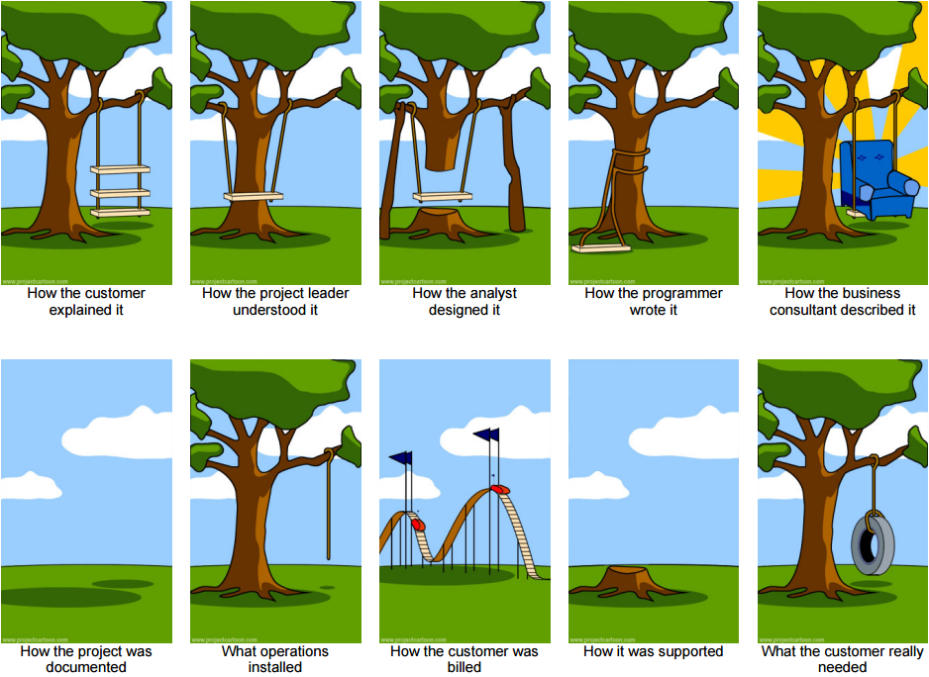
Systems Development IRL
Notes:
Customer needs more throughput and this is what they asked for. Nobody likes admitting they have a problem that they don't know what to do about; thus they would like you to focus on their solution idea, not belabor their problems.
It should have a wide scope and improve all branches of the customer's business
OK, if that's the way you want it, we will focus on the branches
"A swing tied to a tree." That's what you asked for, that's what you got. And now, you don't like it? You know doing it over again means it will cost more and take longer. We'll try to reuse some of the code.
We all wish it could be that way: comfortable, surrounded by sweetness and light. The sales people not only wish it, they believe it. Everything is easy for those who are not doing the work of implementing and deploying,
Nobody knew what was going on anyway.
It's the best we could do given the timeframe and resources available. Given a few procedural changes, it will work like a swing.
A lot of time and materials went into this project and the invoices reflect that.
After looking at the issues log, this seemed the best approach (most merciful solution).
Oh, well. Lesson learned. On to the next project…
The classic original version
http://www.projectcartoon.com/cartoon/3
Expanded version:
http://www.projectcartoon.com/cartoon/2096040
Software development consulting
http://www.projectcartoon.com/cartoon/1078
The life cycle of a software development project with a consulting organization.

Slide 14
Introduction to Software Versioning, Software Release Numbering, and Software Version Control Systems
keep OS, apps, and firmware up-to-date within the major release.
When to install a new major release?
6 months after n.0 (point zero) release
or at the n.1 (point one) minor update
Backup first! Have a roll-back plan.
Notes:
What happens when you don't keep your patches up to date?
Google: Equifax data breach
Unless you really NEED a new major release, wait.

Slide 15
Software Development Versioning
Software development is typically never finished.
At some point, it is finished enough to be released.
We continue to add features, new functionalities, and fix bugs in the code.
Development Stage
Release Stage
0.1
0.2
1.0a1 (Alpha1)
1.0a2 (Alpha2)
1.0b1 (Beta1)
1.0b2 (Beta2)
1.0 rc1 (Release Candidate 1)
1.0 rc2 (Release Candidate 2)
1.0.0 "point zero release"
1.0.1 bug fix
1.0.2 bug fix
1.1.0 feature enhancement
1.1.1 bug fix
1.1.2 bug fix
1.2.0 feature enhancement
1.2.1 bug fix
2.0.0 new version "point zero release"
Notes:
This slide indicates a typical revision schedule for software
In the development stage, only a two numbering system is used: 0.1, 0.2, etc. Each number indicates a new build of the software.
When the software project is complete, the numbering of 1.0 is given, and the word Alpha is appended. This means that the software is not stable and has major bugs, preventing some of its features from working. The Alpha number is increased to indicate revisions in the code – usually bug fixes which improve functionality or performance.
After the major bugs have been fixed and the software is stable, the Beta phase is commenced. Notice that the numbering is still 1.0 throughout this timeframe.
When all of the known bugs have been dealt with and the software now performs as expected, the Release Candidate phase is begun. This phase provides an opportunity for selected public members to download the software and try it out. During this phase, bugs are usually discovered as well as compatibility issues due to specific system configurations. This gives software developers a method to test the software in a real world environment, but without the pressure of officially launching the software. During this phase changes are made to fix configuration issues and bugs.
When the software is really for public release and announced as a finished product, it is given the numbering of 1.0.0 (typically the last number if it is a 0 is not written, i.e. 1.0)
1.0.2 – announces bug fixes from 1.0.1 and is backward compatible with 1.0.1 and forward compatible with 1.1.0.
1.1.1 – is backward compatible with 1.1.0, but is not forward compatible with 1.2.0 because of new features or formats.
2.0 – is not backward compatible with 1.2.1, and will not be compatible with 2.1, when it is developed.

Slide 16
Software Release Numbering
3.4.2
Major release (new version) Can be forward and backward compatible if architecture is not changed.
Minor update (feature enhance) Must be compatible within Major release but not necessarily forward compatible with next Major release.
Micro revision (bug fix) Must be forward and backward compatible within the Major release, i.e. doesn't break things
Notes:
Backward compatibility allows for interoperability with an older legacy system, or with input designed for such a system, especially in telecommunications and computing.
e.g. plug a 50 year old analog rotary (pulse) dial telephone into a land line wall jack…will work if the digital telephone system with tone dialing is still backward compatible. New telephone systems were backward compatible for decades with old equipment, both internally within their own systems as well as at the handset end. But your new VoIP box is not backward compatible with your old dial phone.
e.g. software that can read old file formats such as early versions of jpeg or PDF files.
e.g. software that works with old hardware devices …there is a limit. Are any OS backward compatible with punch card readers or tape drives anymore?
A new game controller may be designed to be backward compatible so that older versions of game software and game consoles can be forward compatible.
Forward compatibility can be designed into a standard. ISO standard PDF/A is a future-proof PDF file format.
From https://www.pdfa.org/pdfa-faq/ Will future developments to the PDF/A standard make current PDF/A versions obsolete?
The ISO standard requires that future PDF viewing applications must be backward compatible, so that they are capable of correctly displaying older versions of PDF/A.
E.g. HTML tags are meant to be forward compatible.
A <P> tag will always mean paragraph tag.
<P align=center> The align attribute is not forward compatible with HTML5, is compatible with HTML4, is not backward compatible with very old HTML.
Browsers are usually forward and backward compatible:
A browser is forward compatible if it will not break when displaying a newer version of HTML, it should gracefully glide over tags and attributes it does not recognize.
A browser is backward compatible if it supports all older versions of HTML including deprecated tags.
"Deprecated" tags and attributes are those that have been replaced by other, newer, HTML constructs. Deprecated tags are still included in the HTML draft or recommendation but are clearly marked as deprecated. Once deprecated, tags may well become obsolete. The draft "strongly urges" the non-use of deprecated tags. Deprecation is the process of gently moving from old to new standards. Programmers creating new code are expected to avoid using deprecated items and if maintaining old code, to convert deprecated items.
https://simplicable.com/new/backward-compatibility-vs-forward-compatibility
The three tier numbering system is a convention adopted by software vendors. The purpose of the numbering system is twofold:
To communicate the order of the releases so you can track the software’s development over time.
To communicate clearly the nature and degree of changes in each release.
Release numbers are groups of numbers separated by dots – the dots are not decimals, merely separators.
The number on the right indicates micro changes to the code base. These are typically bug fixes.
Micro revisions are defined as changes which are forward and backward compatible.
This means that 3.4.2 is backward compatible with 3.4.1. Forward compatibility means that customers who install 3.5.0 should not have any compatibility problems with 3.4.2 clients, except that clients with 3.4.2 will not have the features of the 3.5.0 clients. If there are compatibility issues then it is not a micro change and the minor revision number needs to be incremented.
The minor revision number is typically used to introduce new product features of the software. Changes here must be backward compatible, but not forward compatible. For example, clients who upgraded to 3.4.2 will have no compatibility issues with 3.3.0 clients. The 3.4.2 software can read 3.3.0 files, but may silently change the format to something that the 3.3.0 clients can not be able to read in order to gain new features. Thus, minor changes are always backward compatible, but not forward compatible.
Major changes mark compatibility boundaries. A new major release will have new feature sets or require hardware changes. Thus, a new major release can be forward and backward incompatible. However, if underlying architecture has not changed, the Major release may retain forward and/or backward compatibility with previous releases. E.g. a new release may occur due to a radical change in the User Interface but be compatible with existing/future hardware, OS, and data file formats. Clients who upgrade to 3.0.0 from 2.2.2, for example, will have compatibility issues due to reengineered file formats or incompatible hardware. Or, 4.0 clients will have compatibility issues with 3.4.2 clients because of the new hardware or the new way the software works.
https://en.wikipedia.org/wiki/Software_versioning
Note: Microsoft uses build numbering; see the wiki article.
https://www.w3.org/People/Bos/DesignGuide/compatibility.html

Slide 17
Write programs more easily with versioning
Write all the comments first! SaveAs micro version 0.0.1
Satisfy the comments with code, in small tested steps, adding function as you go:
Start with a basic shell that does VERY simple I/O
Prompt user for a value, output the same value.
Add formula/algorithm that changes Input into Output
Add validation edit(s) for the input.
Add one feature of the program at a time, test, debug.
SaveAs each stage as micro version 0.0._+1
Notes:
Practice software versioning by writing a program in stages, building up its functionality.
Write the comments first!
satisfy the mythical DOWIM compiler (DO What I Mean -- compiler ignores the code and compiles your comments)
programs do what you code, not what you mean.
what do your comments say the code should do?
You don't have comments? How do you know what you mean? If you can't explain it, how can you code it?
How do you eat an elephant? One bite at a time.
Break the program into bite-sized chunks that can work on their own or with the previously debugged code. Add one part at a time.
Debugging:
Leave the problem alone for a while and come back later. A good night's sleep is often the best help you can give yourself. After midnight, problems can take hours to solve. In the morning, they usually take minutes.
Show a colleague your problem. Another pair of eyes can often spot what you can no longer see. Also, explaining things out loud to someone else can often reveal the problem's cause. (Thinking too much can result in infinite loops.)
When testing your logic, make one change at a time and re-test. Making too many changes at once can complicate debugging. When you are all done, re-test everything to make sure a fix did not "unfix" something else.

Slide 18
Software server environments
Who | Develop-ment | Integration & Testing | Staging | Production
Program- mers and System Analysts | All authority. Only place source code is changed. | Most authority. Source code is checked in and compiled. | Application authority. Source code is promoted. | READ ONLY authority. Source code is released.
Business Analysts |  | Application authority | Application authority | READ ONLY authority
End Users |  |  | Application authority | Application authority
Testing: | Unit (program) | System tested with dependent modules. | UAT User Acceptance Testing, User Training | Live (don't even think about testing)
Notes:
Note that the Software server environments follow the SDLC's Design, Develop, Deliver, and Deploy phases.
Hypervisors are sometimes used to host these four separate servers on the same hardware. Movement of files and data between the virtual servers is done at server hardware speed (instead of competing for bandwidth on a real network linking separate server hardware).
All authority = user can change source code, compile, alter database structure, alter data in DB tables.
Most authority = user can compile promoted source code, alter database structure, alter data in DB tables.
Application authority = user can do only what application software allows. Alteration of data in DB tables strictly controlled; i.e. other than by applications. E.g. SQL CREATE and DROP to create and delete tables. INSERT, UPDATE or DELETE data (rows).
READ ONLY authority = user cannot run programs or change data. Can only run Queries to analyze data. Can inspect properties of objects and files.
Software server environments AKA Deployment environments
https://en.wikipedia.org/wiki/Deployment_environment
Environment/Tier Name Description
Local Developer's desktop/workstation
Development Development server. where unit testing is performed by the developer.
Integration System build. For developer testing of side effects of program change in context of existing system, and for technical system testing.
Test/QA/Internal Acceptance business system testing. Quality assurance team make sure that the new code will not have any impact on the existing functionality and they test major functionalities of the system once after deploying the new code in their respective environment(e.g. QA environment)
Stage/Pre-production /External-Client Acceptance User Acceptance Testing (UAT) in a mirror of production environment with proposed changes. Also used for user education and training.
Production/Live Serves end-users/clients

Slide 19
Source Code Repository - Version control
Action | Develop-ment | Integration & Testing | Staging | Production
Check out | Ver 1.0.1 | ⬅ | ⬅ | Ver 1.0.0
Check in | ➔ | Ver 1.0.1
Test & Promote |  | ➔ | Ver 1.0.1
Check out | Ver 1.0.2 | ⬅ | Ver 1.0.1
UAT & Release |  |  | ➔ | Ver 1.0.1
Check in | ➔ | Ver 1.0.2
Test & Promote |  | ➔ | Ver 1.0.2
UAT & Release |  |  | ➔ | Ver 1.0.2
Notes:
How to maintain history of source code, files, and documents? The traditional approach is shown in this slide.
The programmer "checks out" a file/program source from the Production level to a Development system, changes are made to the working copy and unit tested, then the file/program source is "checked in" to the next development level, Integration & Testing. System testing is done and file/program source is promoted to the next level, Staging. After UAT, it is released to Production and becomes the current version. Note that source is checked out from the next highest level so all in-progress changes are preserved. Changes are made ONLY at the Development level.
Version control systems, also called subversion control or revision control, are integral to building software. They combine your repository of project files with a history of all your code changes, making it easy to edit and understand your code over time. Version control helps large projects from spinning out of control by letting individual programmers, writers, or project managers tackle a project from different angles without getting in each other’s way and without doing damage that can’t be undone.
Bug fixes to current version (1.0.n) are in progess with feature enhancement (1.n.0) in progress with major application architecture changes (n.0.0)
https://dltj.org/article/software-development-practice/
RCS to CVS to SVN to Git
RCS was developed to version individual files in a single project on a single server.
Like individual short stories that you can check out of a library and modify. There is only ONE copy of the short story leant to one programmer.
Big problems if those short stories are actually related chapters in a novel.
Strict file locking and mandatory check out
No central repository. Original source code location is the repository. A working directory is used for changes in progress.
OK when all development is done on the production server (not at good idea anymore).
Serial, sequential and hierarchical program changes:
bug fix 1 must be checked in and committed before bug fix 2.
Version 2 must be checked in and committed before Version 3
CVS tracks versions of your project. Can handle multiple projects
Like individual short stories that you can check out of a library and modify but with multiple copies of the same story
CONCURRENT Version System was build on top of RCS
Allows multiple bug fixes or version enhancements to be developed in parallel and merged later
There is only one canonical version of the repository code with changes pending
Added a central repository separate from source code libraries that RCS did not have
sequential and hierarchical program changes with ability to merge separate changes that have occurred in parallel (thus the name Concurrent)
Several developers may work on the same project concurrently, each one editing files within their own "working copy" of the project, and sending (or checking in) their modifications to the server. To avoid conflicts, the server only accepts changes made to the most recent version of a file. Developers are therefore expected to keep their working copy up-to-date by incorporating other people's changes on a regular basis.
CVS assigns sequential version numbers (1.1, 1.2, 1.3, ...) to each file.
easily check out only a subset of the repository.
CVS lets you expand version numbers into each file when checking it out, making it easy to identify which version a file is without reference to the repository it came from.
convenient when the repository is a collection of largely unrelated files, need to track changes on individual files
SVN
It’s like a library where you get to change and add chapters in books.
More comprehensive in scope and function than CVS
dependent on a central repository
There is only one canonical version of the repository code with changes pending
Atomic commit: a set of interrelated changes can be applied affecting multiple files. E.g. changes to ProgramX require concurrent changes to file/tableY (e.g. add a data field or column)
Better collision management with merging multiple versions of a single source file.
an improvement on CVS
revision numbers are sequential across the entire repository; a given number applies to the entire repository, not just a single file
Used when many source files used to build a single program or library; need a coherent history for the project as a whole.
Git is distributed source control, GitHub is the platform for Git providing management and collaboration.
It’s like a library where you get to change and add to the library: short stories, chapters in books, books.
There can be multiple versions of the project on standalone machines – no need for a central server…so where does the code comefrom?
GitHub is the central place to share software development
Disparate changes are easily merged. Has tools for managing possibly conflicting changes from multiple developers
https://subversion.apache.org/quick-start
https://blog.codecentric.de/en/2016/11/a-short-history-in-version-control-systems-rcs-clearcase-svn-git/
https://dzone.com/articles/version-control-git-vs-svn
https://biz30.timedoctor.com/git-mecurial-and-cvs-comparison-of-svn-software/
https://betterexplained.com/articles/a-visual-guide-to-version-control/
https://betterexplained.com/articles/intro-to-distributed-version-control-illustrated/
https://en.wikipedia.org/wiki/Software_configuration_management
https://en.wikipedia.org/wiki/Version_control
https://en.wikipedia.org/wiki/Revision_Control_System
https://en.wikipedia.org/wiki/Concurrent_Versions_System
https://en.wikipedia.org/wiki/Apache_Subversion
https://en.wikipedia.org/wiki/Capability_Maturity_Model
https://en.wikipedia.org/wiki/Capability_Immaturity_Model
http://zo-d.com/blog/Project_Management_-_Immaturity_Model_v3.pdf

Slide 20
VCS – Version Control Systems
Apache Subversion (SVN)
Traditional revision control and software versioning
CENTRALIZED management and repository ('repo')
One version of the truth with 'deltas' – net change history
Checkout the newest version only to working copy
can lock further check outs.
Hierarchical, serial promotion process
Git (GitHub is a hosting service for Git repositories)
Source Code Management invented for Linux by Torvalds
DISTRIBUTED VCS, everyone has the 'repo'
Multiple versions of the truth. Parallel development with sophisticated merge to promote code.
Notes:
SVN relies on a centralized system for version management. Simply put, this means there’s a valid directory (repository) which all users can access. Given that changes to files and documents aren’t linked with one another, this system prevents two users from simultaneously editing the same file. Following this set-up, the first user who accesses a file also presides over its editing rights, rendering it unavailable to other users to work on. Apache Subversion is also capable of allowing any subpath to be downloaded and edited independently from the rest of its corresponding directory tree. This flexibility allows different users to be allocated varying read and write permissions for all paths.
Git is supported by a distributed version control system. And while there’s a central repository into which all changes flow, all users are still able to download their own working copies. This gives users access to the entire repository, including the history, and frees them from having to maintain a constant connection to the network. What’s more, changes are quickly transferred into the main repository. In accordance with this setup, Git doesn’t offer a lock system; instead, each user generates its own branches that are then uploaded into the main repository.

Slide 21
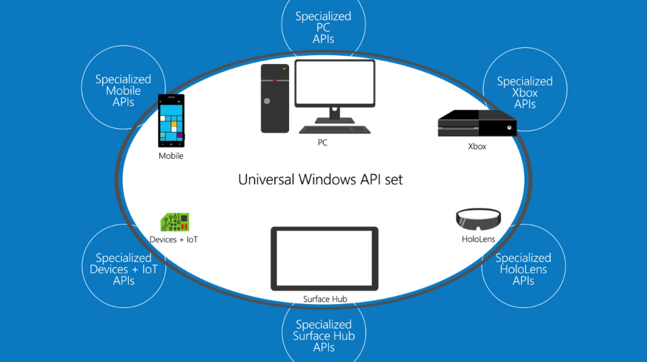
Application Programming Interface (API)
Notes:
APIs are the glue between the OS and Apps. Your app wants to prompt the user to open or save a file. The programmer does not want to know how to navigate the storage hardware or the directory tables to hardware addresses or even the dialog box that the user sees. Press Ctrl-O in Word or PowerPoint. Do you want to write that? And do it again for each platform? Not any more. We use APIs. An API is, loosely, a procedure call with parameters. E.g.call OpenFile([path\]fileName, fileHandle). Your program asks the OS for a file by name, the system sends back a “handle” which is an OS reference to that file, now opened and allocated to your program. Your program uses the handle to read and write the file, and finally close it.
The benefit is that a single API makes the applications more “portable”. For example, an application written for a Windows PC, could work on Surface Tablets, Windows Phones (not too many of those), Xbox, and Windows Server. The local implementation of the API will be different depending on the platform, but your program will not know the difference.
The disadvantage of this approach is that the APIs must be rigidly defined and adhered to which can limit programming flexibility. Advantage is… changes to an OS or hardware can be made without changing the API interface. The OS or hardware can be overhauled and improved without breaking application software because the API remains the same.
See https://www.youtube.com/watch?v=s7wmiS2mSXY in this week’s activity.

Slide 22
Additional notes

Slide 23
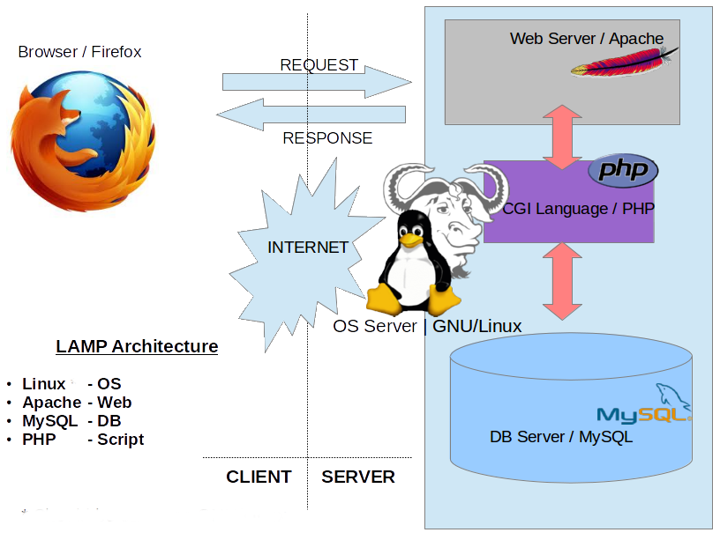
LAMP stack
Attribution: K7.india at English Wikipedia
Notes:
Inside the LAMP stack.
CGI - Common Gateway Interface, a standard for dynamic generation of web pages by a web server. Allows a web page to call a program.
PHP - PHP originally stood for Personal Home Page, but it now stands for the recursive acronym PHP: Hypertext Preprocessor.
GNU: GNU's Not Unix (another clever recursive acronym…and RMS is clever. Google: RMS GNU)

Slide 24
Software Terminology
Program
EXecutable File (EXE) MS Word
Process
Program in execution (loaded in memory) WINWORD.EXE
Threads
Tasks performed inside the process - mouse clicks - spell check - send to printer
Important OS Terms
Notes:
Program – a program is an application in an executable file, commonly with an EXE and/or DLL (Dynamic Linked Library) file extension. For example MS Word’s WINWORD.EXE. It is a file on a drive ready to be executed, i.e. run.
When a program file is run, the OS creates a process. Unique resources are reserved and memory addresses allocated for each process.
Some programs like PowerPoint will have a single process with one or more threads (AKA child process or sub-process) for each PPT file being edited. Other programs will have separate processes for each task, e.g. Chrome. [ use Task Manager to show WINWORD.EXE as the process for MS WORD ]
Inside a process, a specific action is performed in a “thread”. More than one thread can run concurrently. For example, a thread listens for a mouse click, another thread waits for you to finish typing a word and spell checks it. You can print a document and immediately continue using Word while the printing thread runs in the background.
Programming with threads is covered in our object oriented programming classes using C++, C# or Java.
About Processes and Threads
https://msdn.microsoft.com/en-us/library/windows/desktop/ms681917(v=vs.85).aspx
"Each process provides the resources needed to execute a program. A process has a virtual address space, executable code, open handles to system objects, a security context, a unique process identifier, environment variables, a priority class, minimum and maximum working set sizes, and at least one thread of execution. Each process is started with a single thread, often called the primary thread, but can create additional threads from any of its threads.
A thread is the entity within a process that can be scheduled for execution. All threads of a process share its virtual address space and system resources. In addition, each thread maintains exception handlers, a scheduling priority, thread local storage, a unique thread identifier, and a set of structures the system will use to save the thread context until it is scheduled. The thread context includes the thread's set of machine registers, the kernel stack, a thread environment block, and a user stack in the address space of the thread's process. "

Slide 25
Principles of Operating System Design
Layered Architecture
Modular vs Monolithic Design
Memory Protection
Multi-tasking & Multi-processing
Virtual Memory
Virtualization

Slide 26
1. Layered Architecture
End User
Programmer
Software Engineer
Hardware Engineer
Interface
Application Software
System Services
System Software
Hardware
Notes:
Users use Apps but they don’t change them.
Programmers create Apps and use System Services through APIs (more about that in a moment)
Software Engineers and computer scientists create services and high level Operating System functions that humans see and interact with.
Hardware (Electrical and Computer) Engineers design the hardware and low level system software that lets an operating system talk to the hardware.

Slide 27
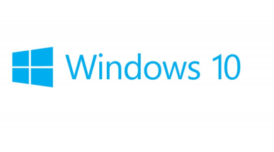

2. Modular vs Monolithic Design
MicroKernel ~50 million lines of source code
Monolithic Kernel version 4.15 23.3 million lines of source code
System Services
System Services Task Management File Management GUI Interface Device Management
Task Management
File Management
GUI Interface (Shell)
Device Management
Notes:
A modular operating system has a clear delineation of functions such as Task Management, File Management, Device Management and a GUI interface. Each function operations as a “stand-a-lone” program, called a service. Each service runs in its own memory space. This makes it easier to update modules without having to change the whole system. It also makes programming easier by defining the function components and “abstracting” them or hiding the details from the programmer.
The opposite approach is to design a monolithic system which provides the same services, but the relationship between the components is not as clear. Consequently, a simple change in one service, could have a “ripple” effect throughout the operating system. For example, a change in hardware could mean that the operating system must be recompiled to incorporate the new device driver in order for the hardware to work.
In a monolithic kernel OS, the program runs as a single large static binary file process running entirely in a single address space. Basic OS services such as task management, file management, and device management all run in same memory space. Entire services are loaded on boot up and reside in memory and work is done using system calls.

Slide 28

Modular vs Monolithic Design
Micro Kernel
Monolithic Kernel
Advantages
More reliable
Easy update, patch, extend
Advantages
Runs faster
Fewer bugs\security issues
Disadvantages
Slower performance
Larger source code
Task Management complex
Disadvantages
Difficult to update, patch, extend
Recompiling kernel time consuming
Notes:
One OS is not better than the other, just different. The question is which one is best for your circumstances, tasks, software availability.

Slide 29
3. Memory Protection
User Mode
Request
Application
Reply
Server Service
User Mode
API
Service Call
Kernel Mode
Executive Services
System Call
Hardware
Notes:
For the operating system to be more reliable, memory must be protected from bad programs or bad hardware.
increased memory protection can also provide increased security.
Thus the system is more reliable because an application program has no direct access to memory, resources or hardware. It only has the ability to request access. The request is done through an API (Application Program Interface – more on next slide), the operating system service will contact the kernel executive services which will make a system hardware call to perform the appropriate action. When the action is completed, a reply is sent back through the stack to the application program that called the API.

Slide 30

4. Multi-tasking & Multi-processing
Operating System appears to run multiple processes at the same time.
Why multi-tasking?
CPU is usually waiting on Input/Output operations
CPU + RAM are fast, I/O is slow
Multi-processing: Separate processes run simultaneously on multiple CPU cores sharing memory and peripherals.
Parallel processing: A single process uses multiple CPUs/cores simultaneously.
Notes:
Since the beginning of operating systems users have wanted to do multiple tasks at the same time and have the ability to switch between running applications. Now, it is considered normal, not so in the early days.
Multitasking uses a single CPU but switches in time slices between tasks (task=application or process).
Multiprocessing means true parallel execution of multiple but separate processes on separate CPUs within a system.
Parallel processing means a single process or task using multiple CPUs simultaneously; this requires specific application programming or an OS which carefully manages a single process's threads to avoid race conditions.
These three types of processing can all occur within the same system. The Operating System controls access to shared memory and peripherals and schedules tasks among CPUs. All contemporary PCs, tablets and smartphones have multiple CPU "cores" on a single chip.
Why multitasking? CPU + RAM are fast, I/O is slow.
MS-Word is formatting your document for printing by sending it to the print spooler which uses a holding area on secondary storage (a drive) to buffer the even slower device.
You’ve asked Outlook to check your email while that happens. But it is slow due to network bandwidth constraints and traffic on your intranet.
So you open a tab in your browser and begin that big download to your USB drive which takes time. Your internet connection is fast (for an outside network connection) and you are using a USB 3.0 device but your older computer has only USB 2.0 ports so the throughput to the your USB drive will be slow. But is the write speed slower than the internet connection? Maybe not.
So you start playing Solitaire. It runs in fast CPU + ram but the I/O to the mouse and screen is slow. Nevertheless, the mouse and screen I/O is usually faster than you can move your hand or read.
Finally, the printer spits out your document, you have new email from your course instructor, the download is finally complete…but you are still playing Solitaire.

Slide 31
4. Multi-tasking
Run
I/O Wait………..….
Run
I/O, CPU wait
Run
Process 1
Time slice expired
CPU Wait
Run
I/O wait....CPU wait
Run
Process 2
Run
Run
Wait
Run
Run
Run
CPU
Notes:
There are many strategies to multitasking depending the needs of the system. Some aspects of the operating system get priority over applications. A PC running your applications treats most apps equally. Your phone pays a little more attention to incoming signals (someone is calling you, a text arrives) than you punching numbers into the calculator app but you don’t notice because you are slowest thing running.
A computer controlling a robot pays attention in “real-time”, i.e. the robot always comes first, its interrupt signals are processed with higher priority than other OS tasks. Real-time responses are often understood to be in the order of milliseconds, and sometimes microseconds. E.g. fly-by-wire aircraft controls, anti-lock brakes in a car. The computer checks for signals from the outside world, from outside its “system boundary”, so frequently that, to a human or the robot, it appears to be operating continuously in human perceived real time. As far as the robot knows, the computer system is always available to process the robot's output and does not delay in directing the robot's next action. In "real-time", the computer is always waiting on the robot, the robot is never waiting for the computer.
https://en.wikipedia.org/wiki/Human_multitasking Human multitasking is an apparent human ability to perform more than one task, or activity, over a short period (1 hour). An example of multitasking is taking phone calls while typing an email and reading a book. Multitasking can result in time wasted due to human context switching and apparently causing more errors due to insufficient attention. Studies have shown that it is impossible to focus on more than one task at a time. However, if one is proficient at one of the tasks at hand, then it is possible to do these tasks.

Slide 32
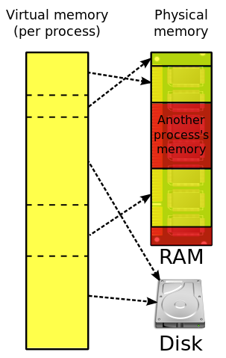
5. Virtual Memory
A 32 bit process uses up to 2GB of RAM.
Many processes can be run even though they exceed physical memory.
Memory management swaps between limited physical RAM and ~unlimited~ virtual memory on a drive.
Multi-tasking switches between processes and may trigger VM swapping.
Thrashing: The system spends more time swapping processes than running them.
It occurs when a computer's virtual memory subsystem is in a constant state of over commitment with a high degree of process switching (multi-tasking).
Notes:
Why can a 32 bit process can access only 2GB of RAM? A 32 bit unsigned integer can address 4GB (long int data types). https://superuser.com/questions/1163749/why-do-32-bit-processes-have-a-2gb-ram-limit "In the NT platform the 4 GB virtual address space is by default divided into 2 parts, the lower 2 GB for process address space and the upper 2 GB for system use."
Virtual memory and caching are memory management techniques developed for multiprocessing operating systems.
Virtual memory is a separate memory space for each program, all programs running may, in total, need more than the actual physical RAM (main memory) capacity. The OS manages this overallocation of physical memory by using slower secondary storage as if it was primary storage. The operating system “swaps” data between these fast and slow areas as needed by the applications running; the applications do not know the difference. To the application, it looks like it has the system to itself with as much memory as it needs. "In the interests of performance, security, and reliability, each process has it's own private 2 GB address space but there is only one system address space. Processes are isolated in their own private address space and cannot see others. System address space is off limits to normal processes and is accessible only to kernel level components such as the OS itself and device drivers. If a process goes astray it can only hurt itself, other processes and the OS are unaffected."
Caching is storing the most frequently used data in the fastest memory. There is expensive, very fast cache memory between the CPU and slower RAM. Available physical RAM is allocated to cache data going to and from slow I/O devices. HDDs have their own caching. Embedded cache on the HDD captures write operations quickly allowing the program to continue asap while the HDD cache and hardware independently perform the slow physical write operations.
Systems that employ virtual memory use hardware more efficiently than systems without virtual memory and make programming of applications easier. Operating systems have sophisticated algorithms to manage virtual memory and caching. The programmer rarely has to worry whether their executable program with its variables and data buffers will ‘fit’ into physical memory. To the program, it looks like it has the entire system to itself with as much memory as it needs.
https://en.wikipedia.org/wiki/Thrashing_(computer_science) Thrashing occurs when a computer's virtual memory subsystem is in a constant state of paging, rapidly exchanging data in memory for data on disk, to the exclusion of most application-level processing. This causes the performance of the computer to degrade or collapse. The situation may continue indefinitely until the underlying cause is addressed

Slide 33
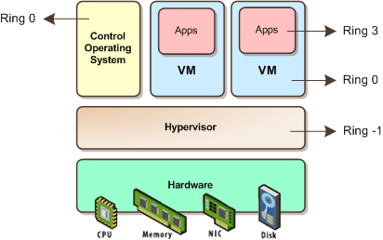
6. System Virtualization with Hyper-V or VMware
Picture taken from: http://itechthoughts.files.wordpress.com/2009/11/vbasics10.png?w=412&h=258
Notes:
A strong trend in business today is system virtualization. VMware has built a huge business doing this on the Intel platform. IBM did it long before on mainframes and Power System-i. Because CPUs are grossly under utilized, system virtualization allows businesses to run multiple instances of the same or different operating systems on the same hardware to better utilize its resources. This saves money on buying more machines, the space needed to house those machines, and the electricity to power and cool those machines. Secondly, on the Intel x86 platform, different types software rarely played well together; the web service stole memory from the database service and neither liked the accounting system which clogged the I/O channels. By virtualizing, each major application/service got its own (virtual) machine and communicated through a (virtual) network as if between different servers.
Each “guest” OS is managed by a Virtual Machine (VM) that simulates a complete hardware platform, known as a partition. The VM and IT administrator controls how much CPU, memory, and storage is allocated to each partition.
Linux is increasingly being run on mainframes and midrange servers in virtualized partitions – because it is cheaper to do that rather than run server farms of white boxes.

Slide 34
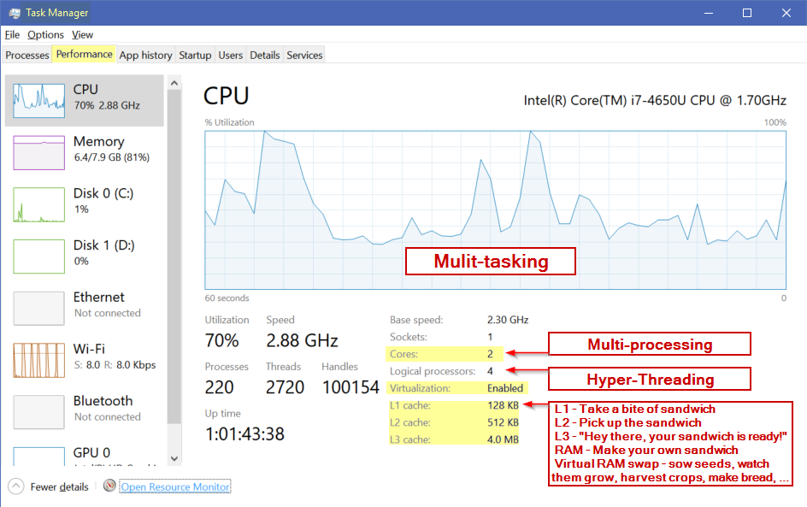
CPU cores and caches
Notes:
Programmers are encouraged to write small modules of code with contained structures (Do loops, If statements) so the code fits in Ln cache: it runs faster and has less chance of being swapped out.
http://www.new-npac.org/projects/cdroms/cewes-1999-06-vol1/nhse/hpccsurvey/orgs/sgi/bentley.html
Intel® Hyper-Threading Technology (Intel® HT Technology) uses processor resources more efficiently, enabling multiple threads to run on each core. As a performance feature, it also increases processor throughput, improving
overall performance on threaded software.
https://www.intel.com/content/www/us/en/architecture-and-technology/hyper-threading/hyper-threading-technology.html
The logical processors in a hyper-threaded core share the execution resources. These resources include the execution engine, caches, and system bus interface; the sharing of resources allows two logical processors to work with each other more efficiently, and allows a logical processor to borrow resources from a stalled logical core (assuming both logical cores are associated with the same physical core). A processor stalls when it is waiting for data it has sent for so it can finish processing the present thread. https://en.wikipedia.org/wiki/Hyper-threading

Slide 35
Hardware components cryptic quiz
What do all these TLAs mean? (Three Letter Acronyms) 4+ letter versions are xTLAs (extended TLAs)
What MOBO is on your machine?
A single CPU, FPU, or GPU may contain multiple ALUs.
RAM, SDRAM, DDRn (main memory, volatile)
BIOS, EEPROM, UEFI (firmware, non-volatile memory)
SSD, HDD, CD-ROM, FDD (2ndary, non-volatile storage)
USB, SD card
SIM card (in the computer occasionally used to talk to other people)
NIC, Wi-Fi
Nothing on this slide will be on the quiz.
Notes:
➔ These will not be on the quiz.
MOtherBOard
Machine – what geeks call computers
Central / Floating-point / Graphics Processing Unit, Arithmetic Logic Unit performs calcs on integer binary numbers.
Synchronous Dynamic Random-Access Memory (SDRAM) is any Dynamic Random-Access Memory (DRAM)
DDR - Double data rate synchronous dynamic random-access memory (DDR SDRAM), DDR versions 1 - 4
BIOS – Basic Input/Ouput System that boots up a computer from an EEPROM Electrically Erasable Programmable Read Only Memory
UEFI - Unified Extensible Firmware Interface (UEFI) is a specification that defines a software interface between an operating system and platform firmware. UEFI replaces the Basic Input/Output System (BIOS) firmware interface originally present in all IBM PC-compatible personal computers,
SSD solid-state drive , Hard Disk Drive, Compact Disc-Read Only Memory, Floppy Disc Drive
USB – Universal Serial Bus, Secure Digital Card (SD card)
SIM (Subscriber Identity Module)
NIC – Network Interface Card
Wi-Fi = Wi-Fi Alliance hired Interbrand to create a name that was "a little catchier than ''IEEE 802.11b Direct Sequence.' Wi-Fi is a word invented as a pun upon the word hi-fi.

Slide 36
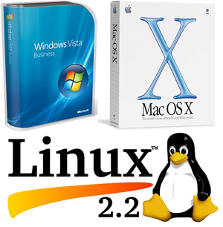
Notes: Short History of Small Systems OS
Notes:
Not on the quiz…

Slide 37
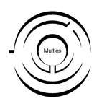







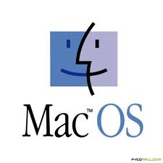

Simplified History of mini and micro systems…
problem was to fence
Notes:
In 1964, a project called “Multics” (Multiplexed Information and Computing Service) was launched. This was the first open source project to develop a multiuser, multiprocessor OS. ( the term open source had not been developed yet) The project leader was MIT with major contributors from General Electric, and Bell Labs (the research division of AT&T). See https://en.wikipedia.org/wiki/Multics
Multics was not a success. However, the ideas in Multics went on to be very successful.
The design and features of Multics greatly influenced the Unix operating system, which was originally written by two ex-programmers from the older project, Ken Thompson and Dennis Ritchie. Ritchie developed C to develop UNIX. The name Unix (originally Unics) is itself a pun on Multics. The C language allowed the OS to be very portable (unlike the Assembler of Multics) requiring only a relatively small amount of machine-dependent code to be replaced when porting Unix to other computing platforms. This greatly contributed to its success.
UNIX was designed by computer scientists for computer scientists to conduct research. The earliest distributions of Unix from Bell Labs in the 1970s included the source code to the operating system, allowing researchers at universities to modify and extend Unix. As the project matured, some of the contributors to the project decided in 1983 to create commercial versions of the OS, System V (five) -- which is why today there are many different versions of UNIX IBM AIX, HP/X, Solaris. Through the 1970s and into the 1980s, the University of California at Berkeley continued to share its version of UNIX, known as the Berkeley Standard Distribution (BSD).
Subsequently, many lawyers became rich sorting out whose UNIX intellectual property was whose. The 1992 lawsuit and injunction on distribution slowed development of the free-software descendants of BSD. Linus Torvalds has said that if 386BSD or the GNU kernel had been available at the time, he probably would not have created Linux.
OpenBSD descended from BSD after the lawsuit dust settled. It is important as an OS because it has different goals than Linux. The MAC Leopard OS and iOS are a BSD-based variants.
VMS operating systems was developed by DEC (Digital Equipment Corporation) for its VAX line of computers and in the 80’s the VAX was the most popular minicomputer (small mainframe, VAX is also in common use today along with the IBM iSeries or PowerServer with IBM-i or the original AS-400 which is taught at Seneca) and is still in common use today.
VMS is important for 2 reasons:
it was the first to develop the use of Virtual memory which is now a standard feature of all operating systems.
the project leader for VMS was a man by the name of Dave Cutler, who had worked on both Multics and UNIX projects.
DEC was purchased by HP and today, HP is project leader for OpenVMS (the latter is not open source, but uses open standards)
CP/M stands for Control Programming Module. It was designed by Gary Kildall when he worked for Intel. He left Intel and formed a company called Digital Research Inc (DRI) Unlike UNIX, CP/M is a single user, single task operating system. CP/M is important because it was the first operating system designed for the new microcomputer (PC). IBM had developed the PC hardware but it not have an operating system. IBM failed to come to licensing terms with DRI and turned to a new company called Microsoft to develop the OS. Microsoft did not actually have or own what it sold to IBM at the time of the deal. Microsoft later bought all rights to a clone of CP/M called QDOS (Quick and Dirty Operating System) for $75,000 and renamed it PC-DOS for IBM, the Personal Computer Disk Operating System. Bill Gates wisely negotiated a non-exclusive arrangement with IBM so Microsoft could sell MS-DOS. Because everything in the IBM PC was off-the-shelf components except for the BIOS, the clone computer market could flourish. MS-DOS was the basis of the Microsoft residential code base for the Windows 9x operating systems (Windows 95, 98 and Me).
Microsoft wanted to develop a new operating system that could be used for large commercial enterprises. In 1988, Microsoft formed what would become the development team for the Microsoft Windows NT® product. The team's goal was to develop a 32-bit, multi-user, multi-process operating system that was better than UNIX. At the same time, DEC had cut back on Dave Cutlets project to build an more efficient OS, not based on UNIX design. Discouraged by DEC ‘s decision, Microsoft was able to hire Dave Cutler and most of his programming team to develop this more efficient OS which became known as NT (New Technology AKA Not Today). DEC also believed Cutler brought source code to Microsoft and sued. Microsoft eventually paid US$150 million and agreed to support DEC's Alpha CPU chip on NT.
https://superuser.com/questions/1163749/why-do-32-bit-processes-have-a-2gb-ram-limit
"In the NT platform the 4 GB virtual address space is by default divided into 2 parts, the lower 2 GB for process address space and the upper 2 GB for system use."
This was a design decision made in the interests of performance, security, and reliability. Each process has it's own private 2 GB address space but there is only one system address space. Processes are isolated in their own private address space and cannot even see others. There is provision for sharing address among 2 or more processes when necessary. System address space is off limits to normal processes and is accessible only to kernel level components such as the OS itself and device drivers. If a process goes astray it can only hurt itself, other processes and the OS are unaffected.

Slide 38
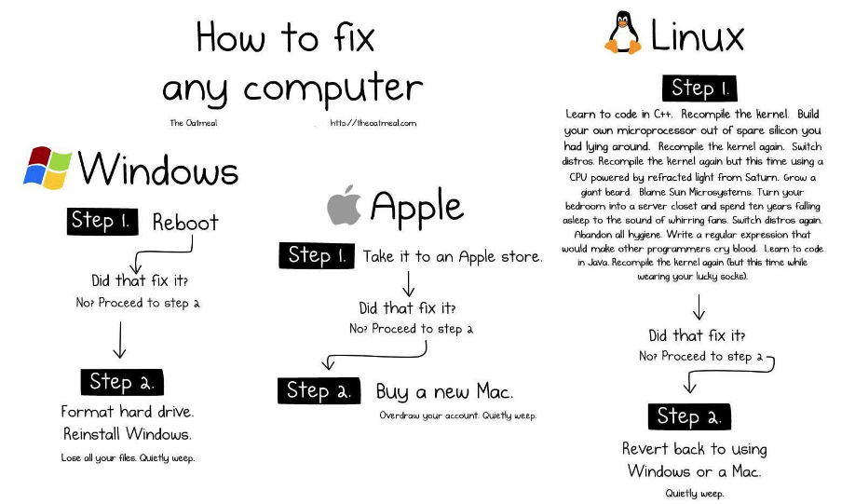
Notes:
Illustration source from http://theoatmeal.com/blog/fix_computer
The age old debate Windows vs Apple. And then there is Linux.
Microsoft designed its operating systems to be compatible with hardware created by a wide range of computer companies allowing for broad distribution. Apple didn’t. The downside for Microsoft was allowing the world’s most complex OS at the time, Windows 95 with 15 million lines of code, to run on the world’s cheapest hardware garnering a reputation for crashing. (Tim McKenna’s personal record to lock up Win95 was 45 seconds after beginning to use a freshly booted machine with a new image.) However, if you ran a Microsoft OS on an IBM PC, it was fine but only if you ran every other version of the OS. (DOS 1, 3, 5 were fine. 2, 4, 6 were stinkers. Windows 95, XP, 7 were OK. 98/ME and Vista were stinkers. Windows 8 and 10 are the only even numbered versions that were not total stinkers.) So Microsoft themselves were half of their own reputation problem. Combine that with people running Microsoft on cheaped-out hardware and it’s no wonder Windows has the reputation it does. Despite that, they have 90% of the small computer market. Go figure.
Macs were not perfect either but no one heard about Mac crashes because there were so few to hear about. Human beings are terrible at thinking statistically and without bias. (Kahneman, 2011. Thinking, Fast and Slow) They pay attention to what they notice most often.
“Operating systems are like underwear — nobody really wants to look at them.” – said by Bill Joy who wrote BSD unix, the vi editor, and much else. https://en.wikipedia.org/wiki/Bill_Joy
An operating system should be like underwear: clean, comfortable, and does the job without you or anyone else noticing it.
Use whatever OS/platform you like. These days, no OS is better than the other, only different. Apple and Linux are no more resistant to viruses and attacks than Windows; today Macs are potentially more vulnerable because there are now enough Macs out there to make them a worthwhile target (having clawed their way from 5% up to 9% market share in 2016), Mac users also have the most money (or had until they bought an Apple product), and many Mac users still think they are immune from malware which is the real problem. Linux, etc. is open source so vulnerabilities can be seen—it’s a race between the Black Hats and the White Hats. Microsoft has many APIs to make the platform customizable for businesses and those APIs can allow holes but Microsoft does have an effective update process.
Apple has better hardware and stability if you compare a Mac to a cheap PC; and a Mercedes car is better than a Kia but no one blames Kia for not being as good as Mercedes. Windows running on quality hardware is as reliable—and as expensive—as a Mac.
The real platform issue for businesses is Total Cost of Ownership, tech support, and compatibility with everyone else in the company.
Somebody dies and goes to heaven. On arrival, St. Peter gives him the quick tour of the place. As they go through heaven from place to place, they look at the mall, the school, the park … and they keep seeing a high wall on one side or the other. Finally, the new arrival can’t resist asking: “What’s with the wall?” St. Peter Answers: “That’s where we keep the Mac users. They like to think they’re the only ones here.”
http://www.macworld.co.uk/feature/mac/mac-or-pc-ten-reasons-why-macs-are-better-pcs-2015-3493363/
http://www.pcadvisor.co.uk/videos/3493092/5-reasons-why-pcs-are-better-than-macs-mac-vs-windows-pc--which-is-best/
https://xkcd.com/934/
http://www.cashen.com/html/os_quotes.html
Complete 66 Mac vs PC ads
https://www.youtube.com/watch?v=0eEG5LVXdKo&t=107s
iPad vs Surface
https://www.youtube.com/watch?v=0NwkczSuwL8
Apple being honest https://www.youtube.com/watch?v=e67OCOMaXXA
Microsoft being honest https://www.youtube.com/watch?v=HU2aLZF3k_0

